Slide 1

Project Stage I Presentation
HealthWatch
ICU MONITORING AND CLOUD INTEGRATION
Computer Department
2024
GROUP 1
MUKTA BAHULEKAR : B1902304221
CHITRARTH KADEL: B1902304296
SAHIL PHULE: B1902304362
SWAYAM SONAR: B1902304381

Slide 2

a
Table Of
Contents
01
INTRODUCTION
05
OBJECTIVES
PROPOSED ALGORITHM/ METHODOLOGY
02
LITERATURE SURVEY
06
03
SURVEY
07
PROPOSED SYSTEM ARCHITECTURE
04
PROBLEM STATEMENT
08
CONCLUSION

Slide 3
Introduction
Integration Of Technology In Healthcare
Technology Is Essential For Patient Safety And Improved Outcomes, Especially In Icus.
Continuous Monitoring Of Vital Signs Is Crucial For Early Detection And Prompt Intervention.
Challenges In Icu Management
Icus Require Quick, Informed Decisions, With Accurate, Real-time Data To Manage Complex Conditions.
Delays Or Manual Errors Can Lead To Adverse Outcomes.
Solutions With Healthwatch
Healthwatch: Icu Monitoring And Cloud Integration Automates Monitoring And Ensures Data Accuracy.
The Solution Provides Actionable Insights, Enhancing Icu Operations With Secure, Up-to-date Patient Information.
Slide No: 1

Slide 4
Literature Survey
Sr. No. | Authors | Publication | Description
01 | Bill Joel D J, Sibi Rajan S,Vibinanth, D Pamela, P Manimegalai | April,2022 | A Cloud Based Data Management System For Health Care
02 | Donthula Akhil, Marepalli Vishnu Vardhan, Kattula Vennela Reddy, Chapala Preetham, Dr. Sangeeta N | May,2024 | IOT Based ICU Patient Monitoring Smart System
03 | Chennamsetty Venkata Ravikanth, Kolangiammal, Kshitij Chegondi, Valluru Gowtham | April,2023 | Cardio Monitoring and Cardiac disease prediction using Machine Learning
04 | Amala Menon, Aishwarya M S, Ms. Anu Maria Joykutty, Asna Yusafali AV, Ashifa Yusafali AV | August,2021 | Data Visualization and Predictive Analysis for Smart Healthcare: Tool for a Hospital
05 | Mohammed D. Aldhoayan, Yosra A. Aljubran | July,2023 | Prediction of ICU Patients’ Deterioration Using Machine Learning Techniques
Slide No: 2

Slide 5
Literature Survey
I-Doc – A Cloud-Based Data Management System For Health Care
Highlights cloud integration for cost reduction and scalability.
Stresses importance of data security with encryption and secure access.
Suggests simple UI design using Bootstrap and Electron frameworks.
Shortcomings: Lacks focus on real-time data and extensive data security solutions.
IoT-based ICU Patient Monitoring System
Details sensor integration with microcontrollers for real-time data.
Uses AWS for cloud integration, providing a cloud architecture framework.
Incorporates machine learning for predictive health outcomes.
Shortcomings: Focuses on alert systems, lacks customizable analytics.
Slide No: 3

Slide 6
Literature Survey
Prediction of ICU Patients’ Deterioration Using Machine Learning Techniques
Provides insights into predicting ICU patient deterioration with real-time data.
Offers comparative performance insights for model selection.
Shortcomings: Relies on static models with limited features.
Cardio Monitoring and Cardiac Disease Prediction using Machine Learning
Describes sensor integration for vital sign collection and cloud processing.
Uses SVM and KNN for cardiac disease prediction, aligning with ICU monitoring goals.
Discusses data preprocessing and model selection.
Shortcomings: Utilizes traditional ML with small datasets, lacks real-time adaptability.
Slide No: 4

Slide 7
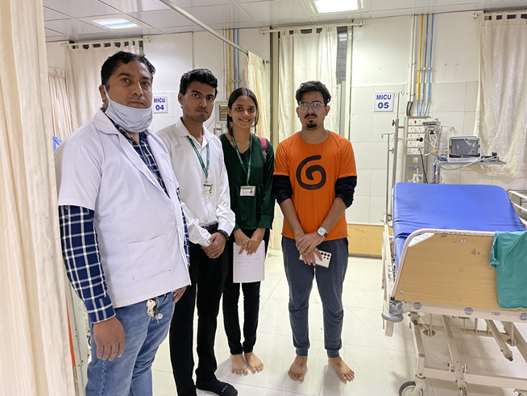
Survey
Conducted to analyze and understand the current system in the hospital.
Survey details
Conducted on August 28th, 2024, at Smt. Kashibai Navale Medical College and General Hospital.
Duration was approximately two hours, covering various hospital wards.
Key insights
Visited ENT, Medicine, Peadiatric, General Surgery wards, and the ICU.
Gathered insights beneficial for project enhancement.
Slide No: 5

Slide 8
Survey
Findings:
The ICU uses a vital monitoring machine called Infinity Delta, developed by Draeger India Pvt. Ltd.
This machine tracks critical vitals like ECG, heart rate, SpO2, pulse, and respiration, which are continuously monitored by nurses and doctors, as ICU patients require constant care.
Like general wards, the data from these machines is manually entered into the hospital’s main system.
There is a centralized system in the ICU that displays basic information of all patients on a single screen.
A basic alarm system is integrated into the machines, which alerts staff through beeping sounds if any abnormality in the vitals is detected.
Slide No: 6

Slide 9


Problem Statement
To address the lack of a centralized system for real-time ICU patient monitoring, data storage & analytics, alerting & triggering.
Slide No: 1
Slide No: 7

Slide 10





Objectives
Cloud-integrated ICU monitoring system
Centralized dashboard and alerts
Data analytics and security
Automation and efficiency
Data registry
Slide no: 8

Slide 11


Proposed Solutions
Development of required devices and their integration in a simple and user-friendly way to help doctors utilize existing technology to its fullest by storing collected data.
STORE
We aim to develop a real-time tracking system in an efficient and affordable way for hospitals to aquire and maintain patient data for future use and risk mitigation.
MONITOR
We aim to streamline the entire patient care process from admission to dispatch by utilizing data to analyze and predict possible diseases.
ANALYZE
Slide No: 8

Slide 12




Methodology
Our plan to meet our aim and build on to our solution
Data extraction
Cloud uploading
Event manager and alert system
Web application development
Slide no: 9

Slide 13
Data Extraction
Here is the information gleaned from our survey regarding the data collection of currently available end devices within the hospital:
Data transmission from Draeger to master system
RS-232 port facilitates both analog and digital data transmission depending on the sensor type (e.g., ECG as analog, pulse as digital).
A microcontroller filters and transmits data to the master system using cables or Wifi.
Multiple microcontrollers can report to the master system simultaneously using a brute force method.
[ECG, respiration, SpO2, Temp_abs, Temp_delta, Pressure, Cuff_press, Cardiac_op] is the format of output
Hardware requirements
RS232 to USB cable
ESP32 per monitor
USB multiport adapter
Wifi router (for wireless connection)
Server/central CPU
Slide no: 10

Slide 14
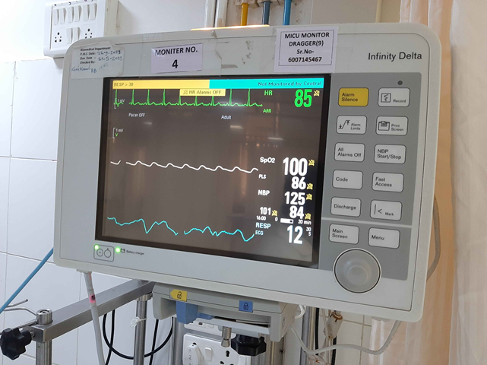
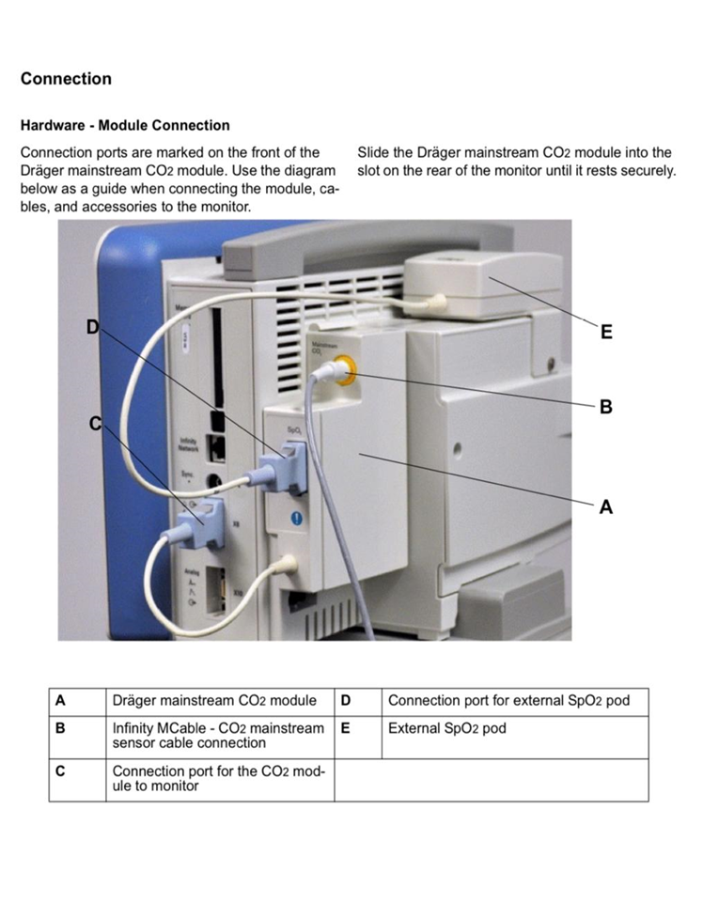
Data Extraction
Slide No: 11

Slide 15
Data Conversion
Some of such systems might have analog data hence to utilize them method is as follows:
For analog output from the monitor:
ESP32 microcontroller analog output
The ESP32 microcontroller features an ADC for converting analog to digital.
It offers a 12-bit resolution, producing digital values from 0 to 4095.
There are two ADCs: adc1 with nine channels and adc2 with ten channels.
Slide no: 12

Slide 16
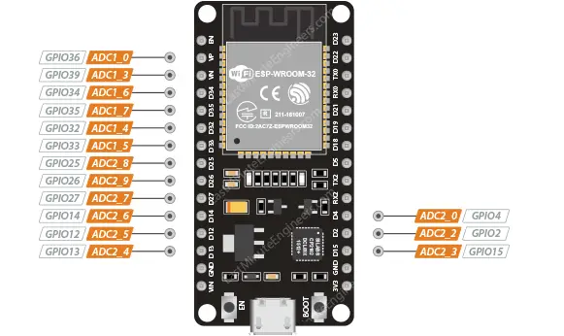
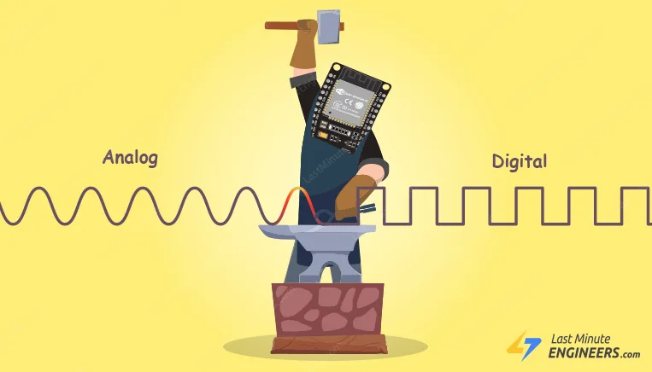
Data Conversion
Slide No: 1
Slide No: 13

Slide 17
Data Collection
How the serialized data is further processed and translated to the database
Node-red is a flexible no-code system based on Node.js.
It facilitates easy and rapid prototyping across various endpoints.
Enables data pre-processing.
Integrates with any storage system.
To elaborate its working, here are some images of node-red of the current project and how it will be utilized
Slide no: 14

Slide 18
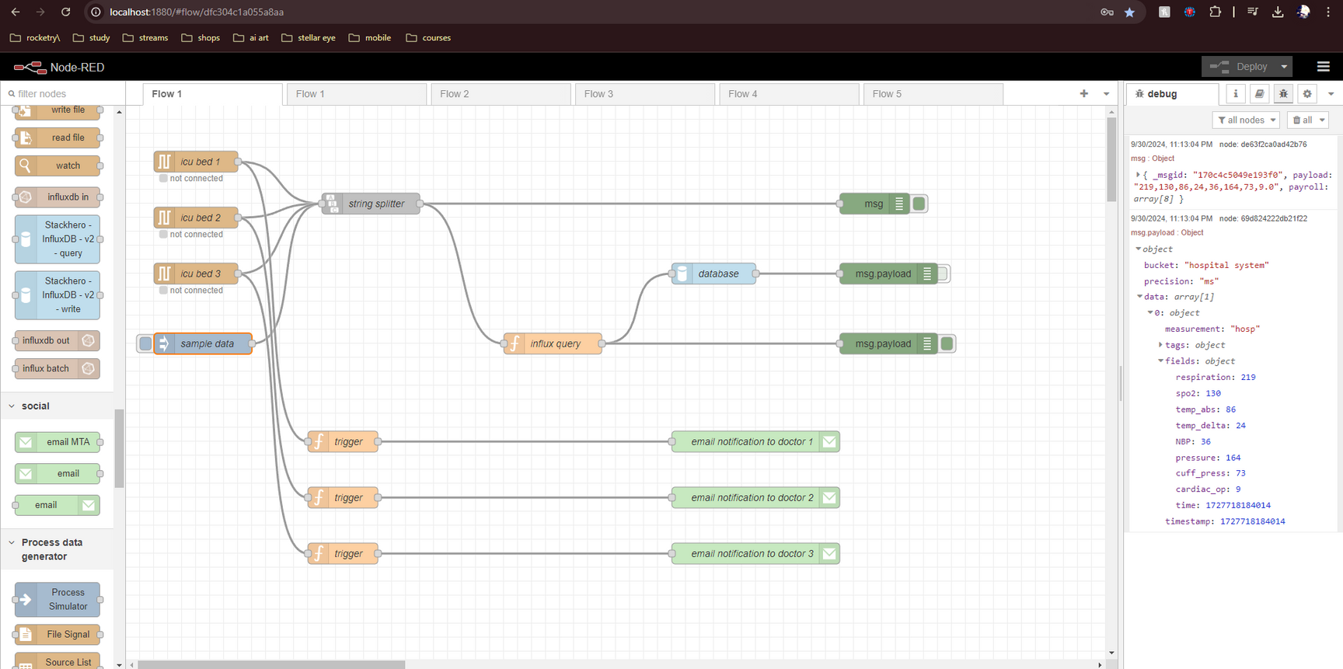
Data Collection
Slide No: 15

Slide 19
Data Visualization
A central dashboard will be utilized to create this centralized system which will be accessible to authorized personal only
Store data in a database for structured management.
Utilize visualization software to create a centralized system for better data representation.
Plan to use an RDS (Relational Database Service) instance for efficient data storage.
Ensure data accessibility and security through the RDS setup.
Enable easy integration with visualization tools for dynamic reporting and analysis.
We would use visualization software like InfluxDB or Grafana to display the data on a dashboard, as illustrated in the provided example image.
Slide No: 16

Slide 20
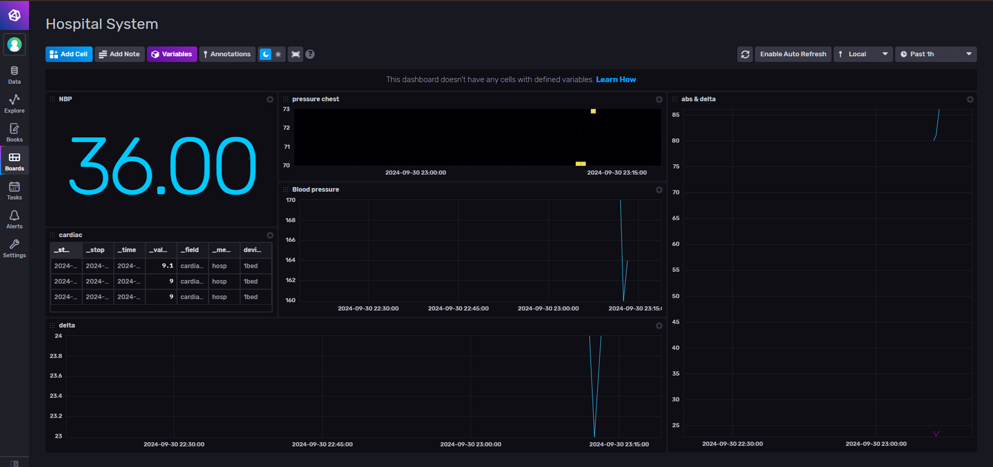
Data Visualization
Slide No: 17

Slide 21
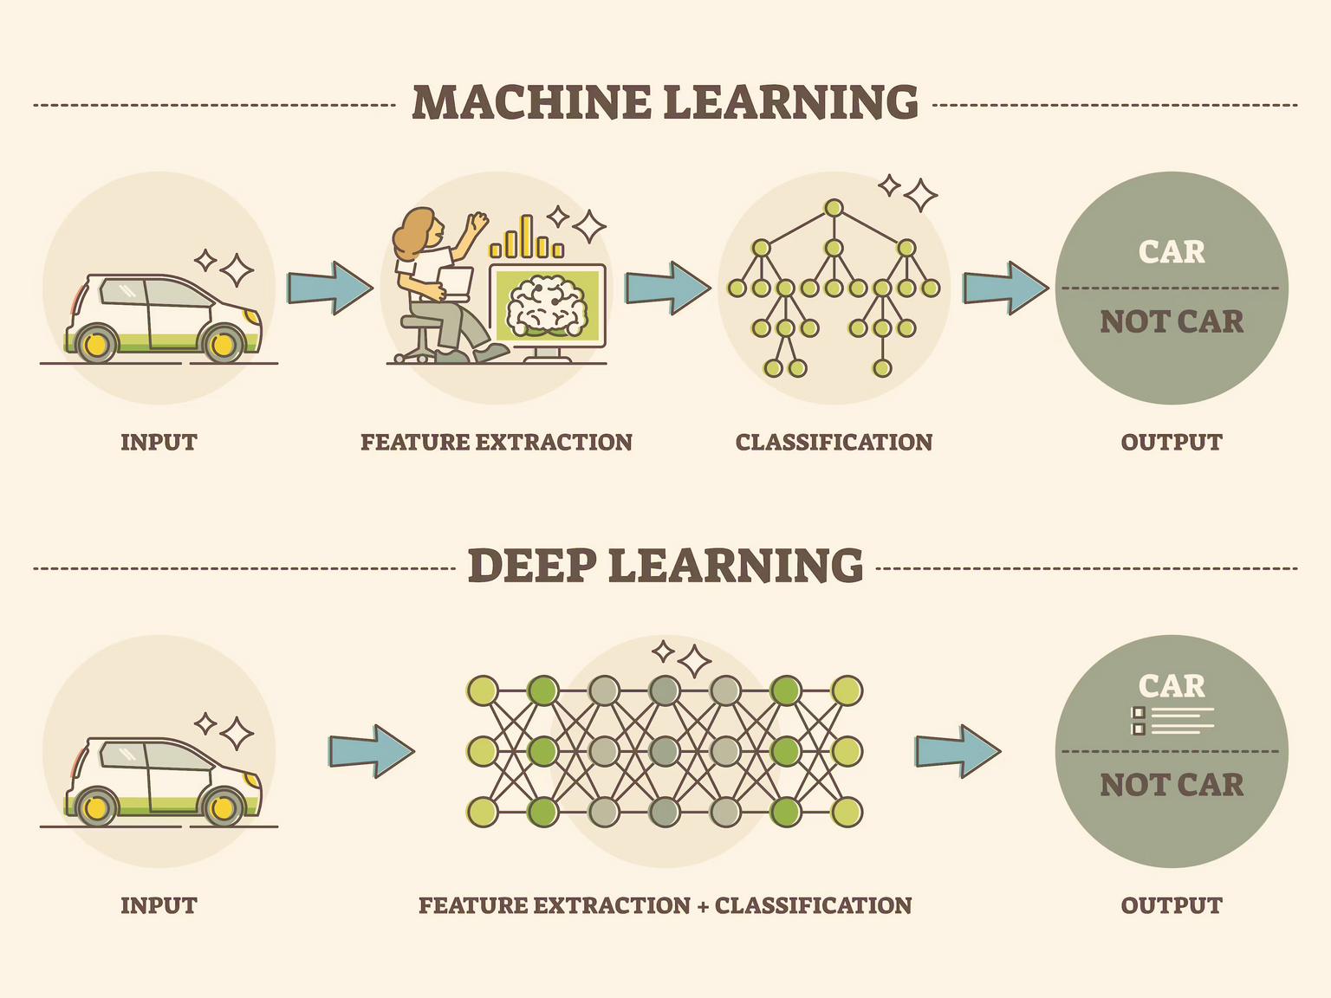
Machine Learning
Cardio Predictive Analysis
IoT devices and ML algorithms monitor cardiac vitals for early disease detection.
Parameters: ECG, body temperature, glucose levels, heart rate.
Method: Data collected by IoT sensors, processed and analyzed using SVM and KNN models.
Benefits: Enables continuous monitoring and early heart issue detection with high accuracy alerts.
Slide No: 18

Slide 22
Machine Learning
Patient Deterioration Prediction
Focuses on ICU patients to predict deterioration using ML techniques.
Parameters: blood pressure, respiratory rate, heart rate, oxygen saturation, body temperature.
Method: Data from medical sensors is processed. KNN models predict deterioration risk.
Benefits: Allows early interventions with scalable, cloud-based real-time monitoring for critical conditions.
Slide No: 18

Slide 23
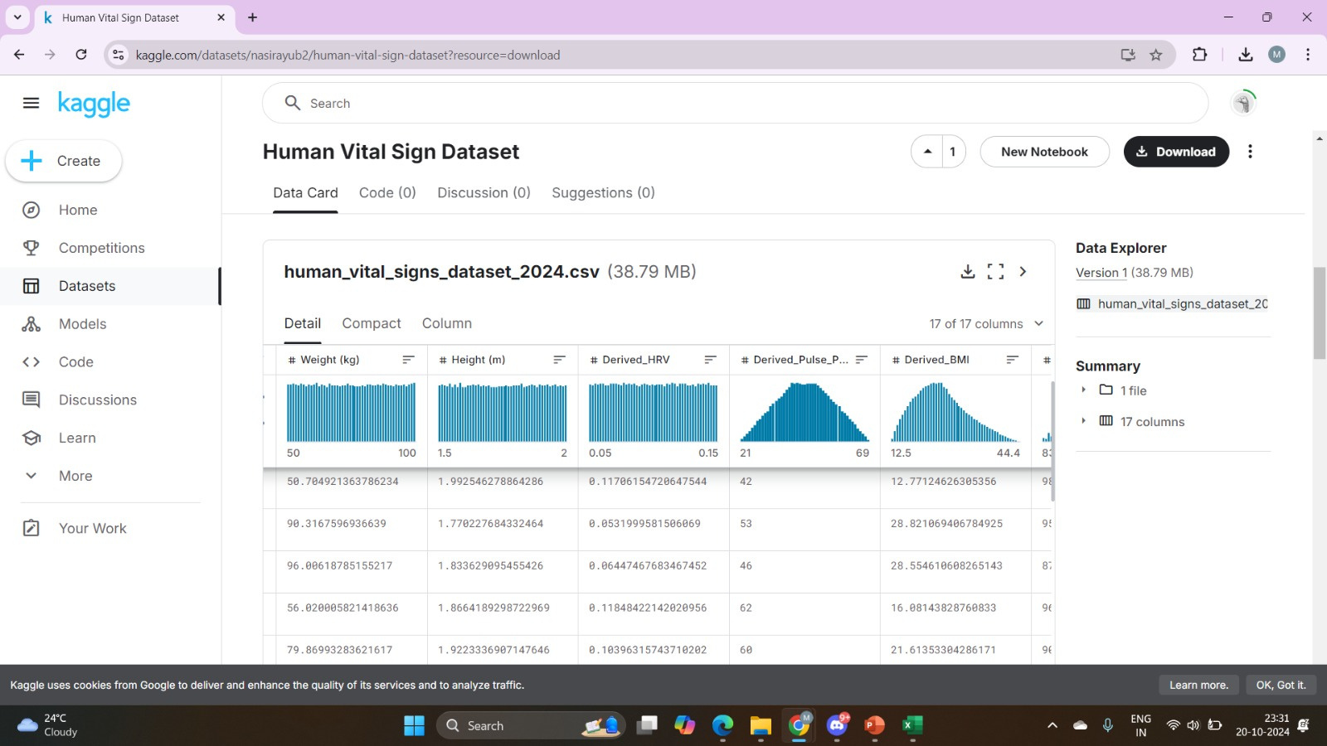
Machine Learning
Slide No: 19

Slide 24
Cloud Integration
Utilizing cloud services is the optimal solution for us due to their connectivity and accessibility .
Security:
VPC will be used to provision resources in private space. Security Groups, Firewalls will be applied at this level to isolate the resources.
B. Hosting:
ECS will be used to run docker containers & will be hosted in above-created VPC. These containers will run web application backend and frontend.
C. Database:
The data generated by the above application will be relational so RDS will be used to store it and access it. It will also be hosted in the vpc and connected to the containers.
Slide no: 20

Slide 25
Cloud Integration
Utilizing cloud services is the optimal solution for us due to their connectivity and accessibility .
D. Storage:
S3 will be used to store the Patient reports and files, which are created at the discharge.
E. Analytics:
Data Analytics will be used to process the data stored in the RDS and identify the patterns through analysis.
F. Alerts:
Triggers and Alerts is used to trigger the push notifications to the doctors and concerned authority either through WhatsApp or mail.
Slide no: 21

Slide 26
Event Management and Alert System
How we will utilize the collected data to generate triggers and help doctors get notified
Generate triggers based on specific patient data.
Notify relevant doctors about patient status.
Alert hospital authorities for appropriate action.
Customizable triggers for healthcare professionals.
Doctors can set specific values tailored to individual patient needs.
Alerts will be generated based on these personalized thresholds.
Emergency notifications will be sent to ensure timely responses.
Enhances patient monitoring and care management.
Supports proactive healthcare interventions.
Slide No: 22

Slide 27
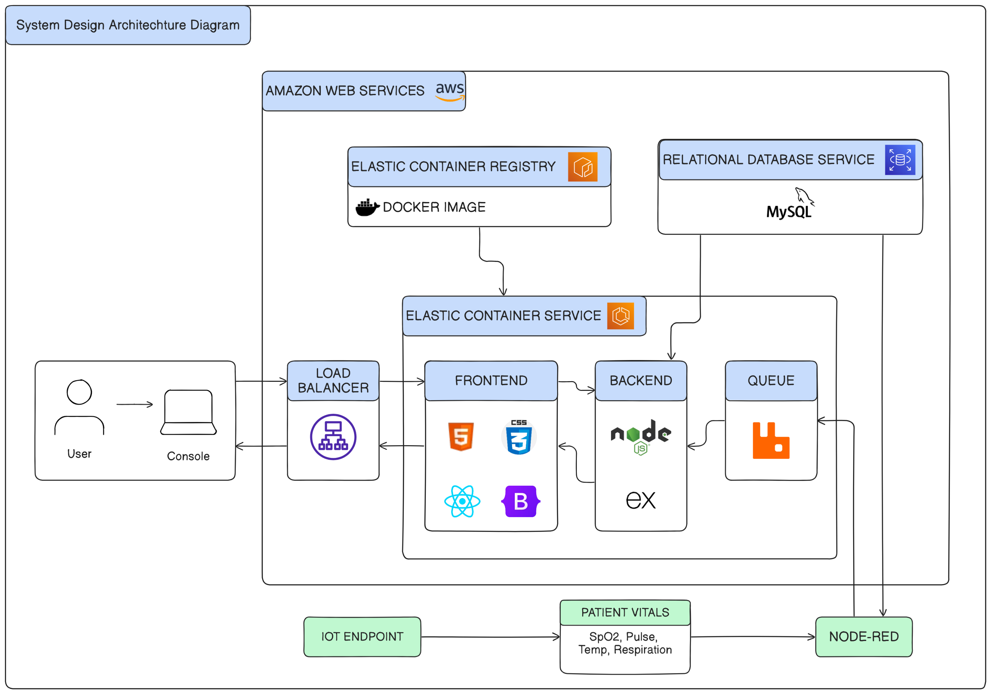
Proposed System Architecture
Slide No: 23

Slide 28
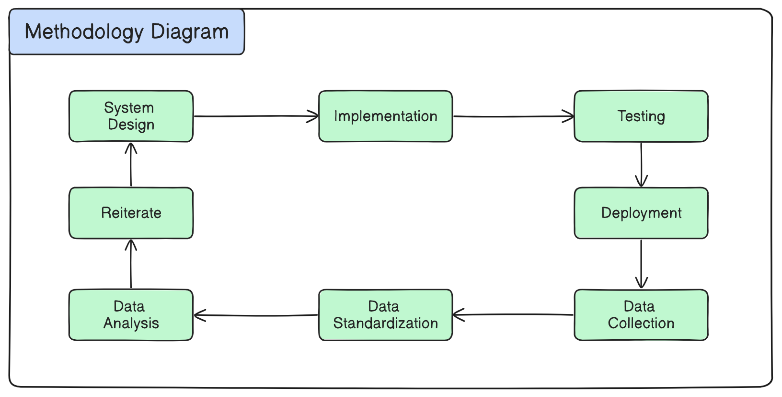
UML Diagrams
Slide No: 24

Slide 29
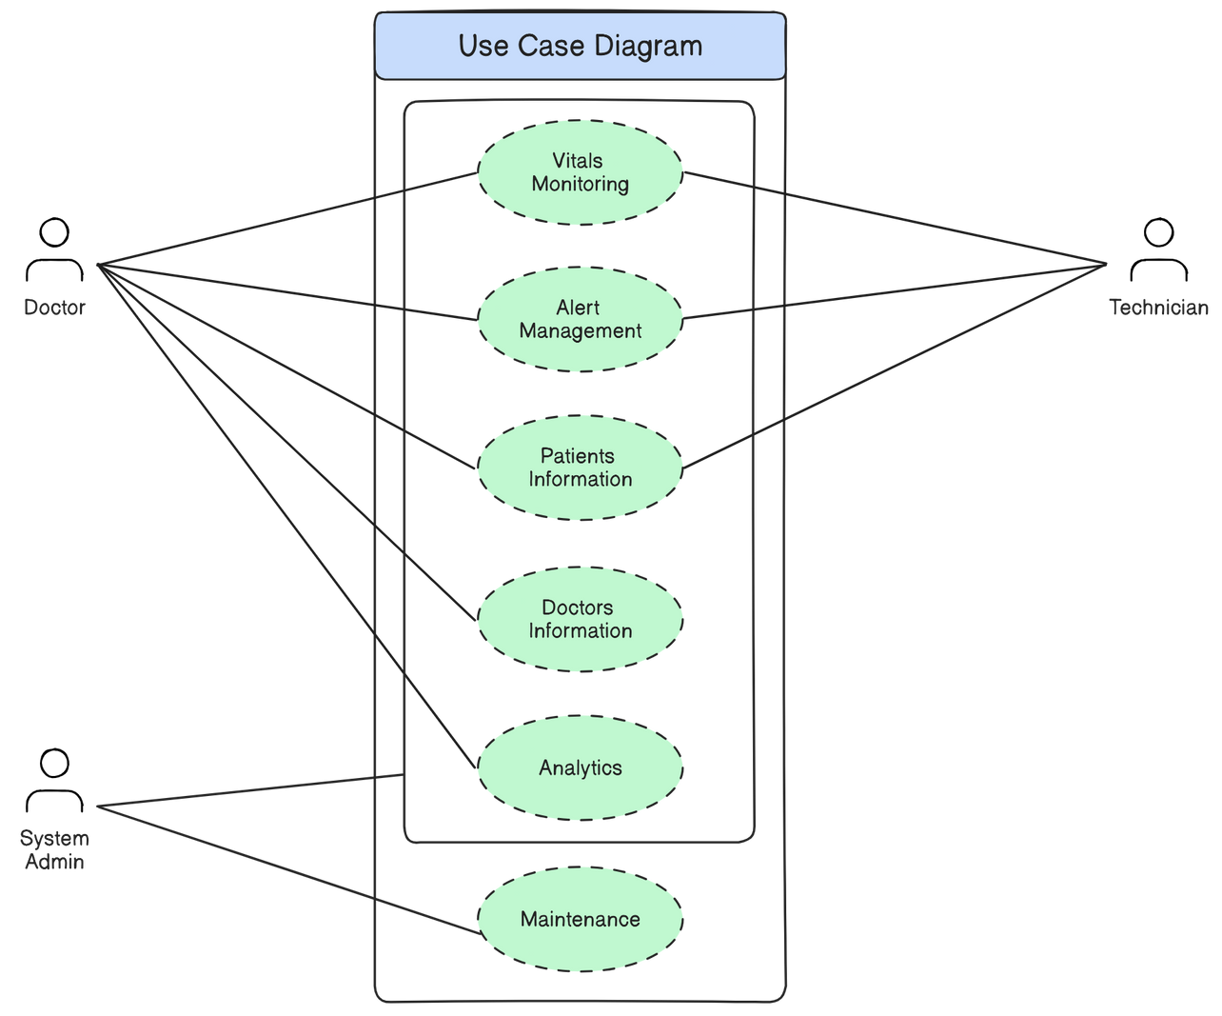
UML Diagrams
Slide No: 25

Slide 30
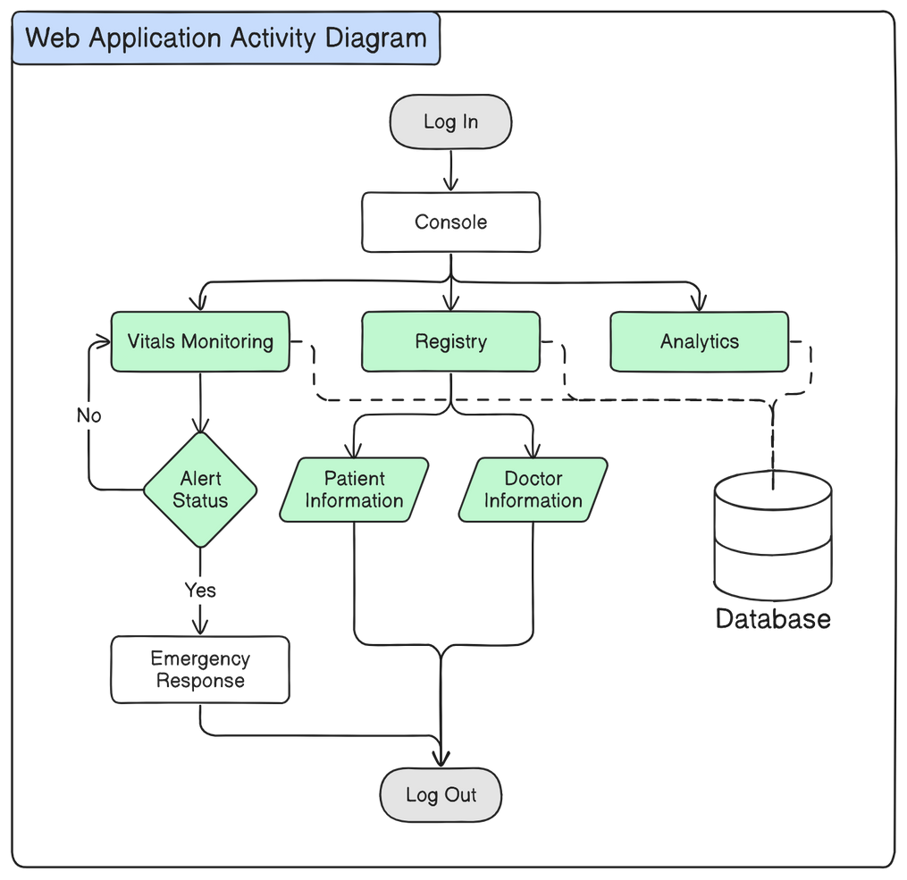
UML Diagrams
Slide No: 26

Slide 31
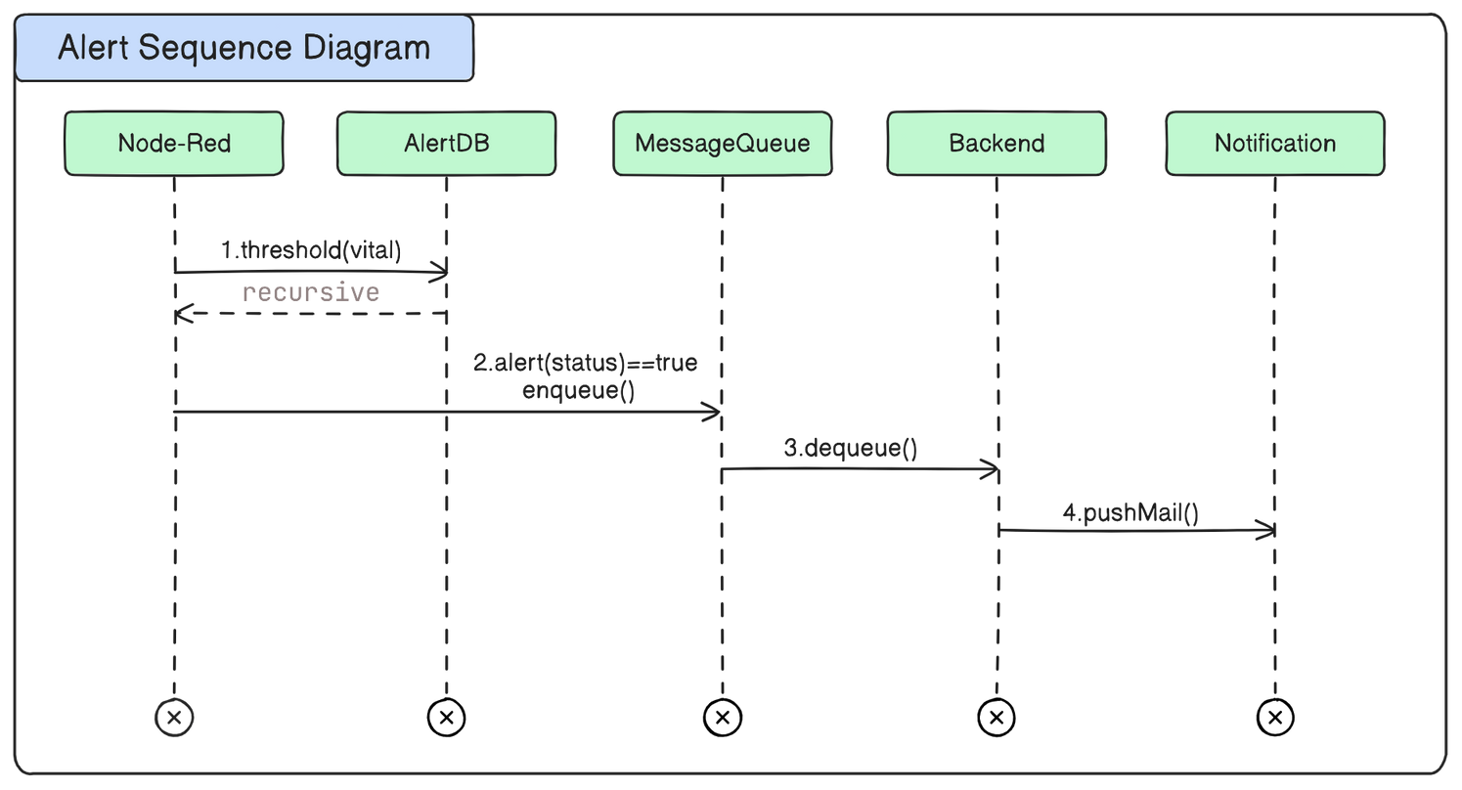
UML Diagrams
Slide No: 27

Slide 32
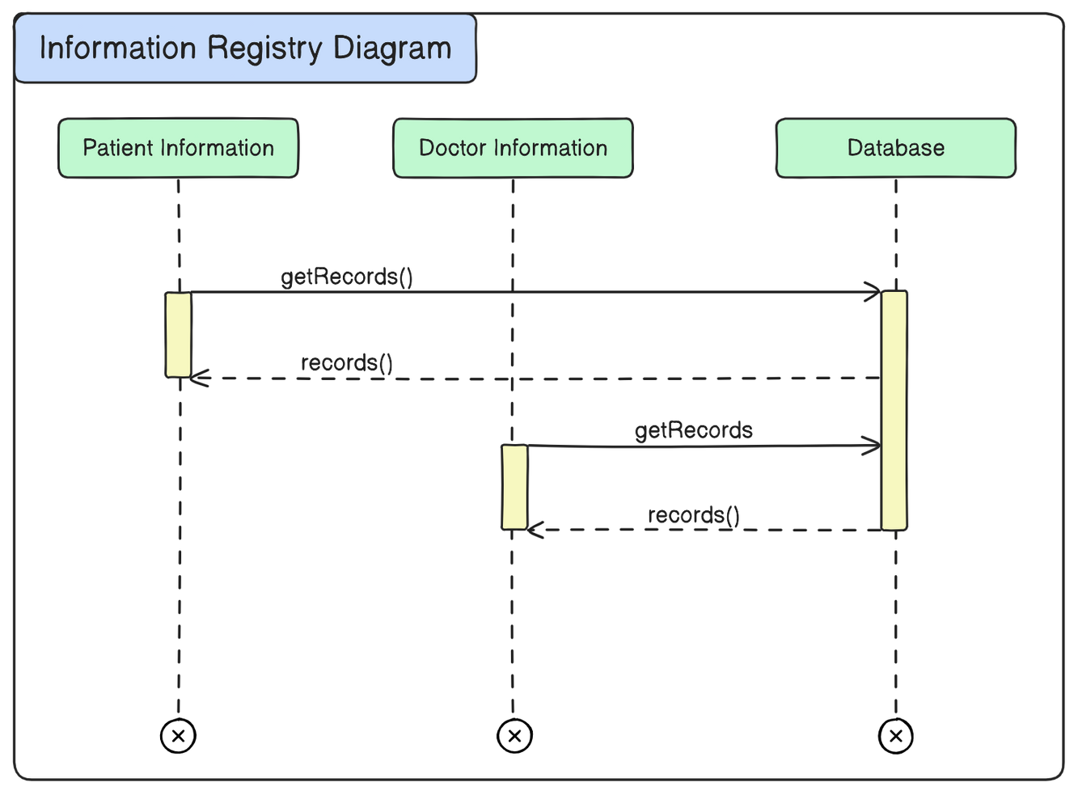
UML Diagrams
Slide No: 28

Slide 33
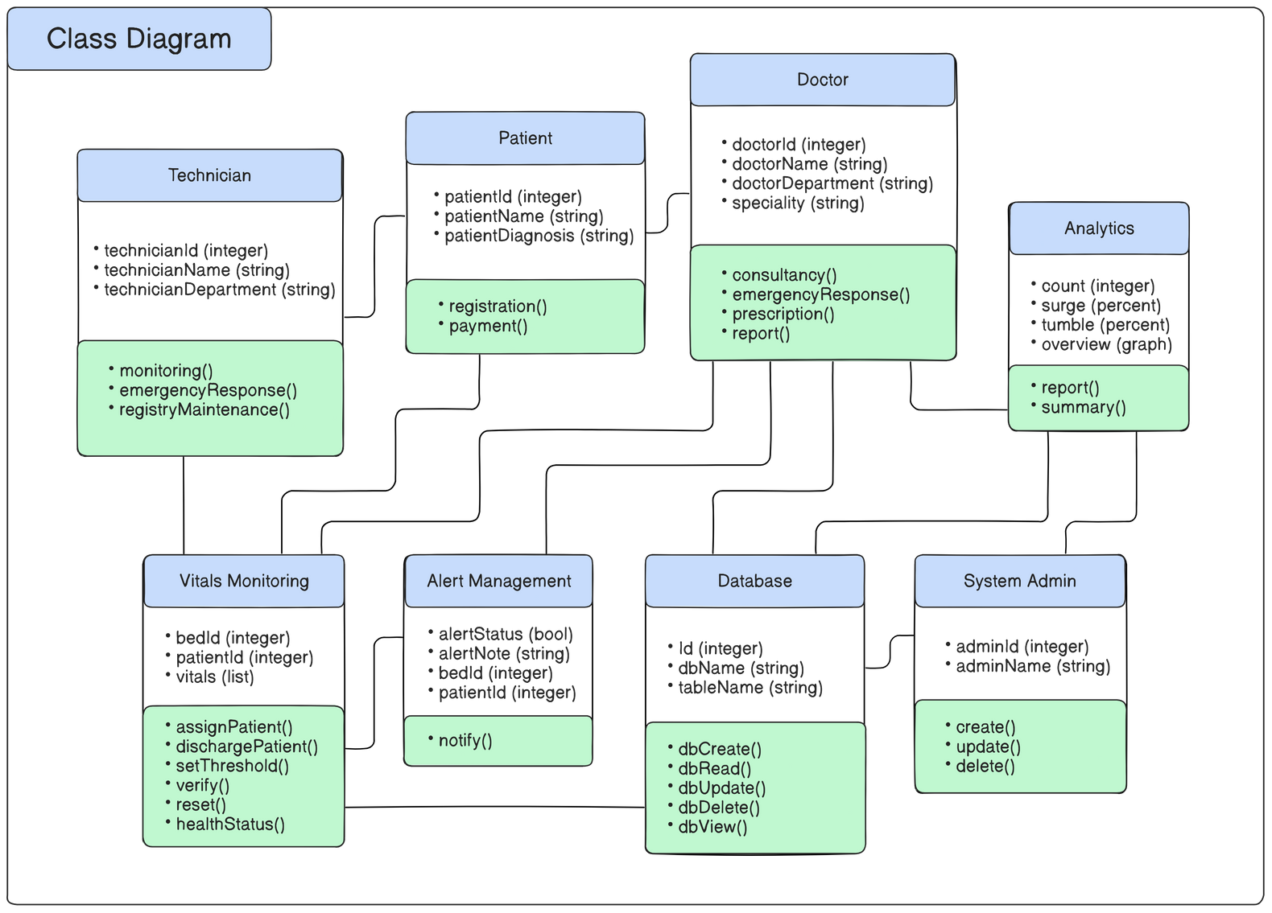
UML Diagrams
Slide No: 29

Slide 34
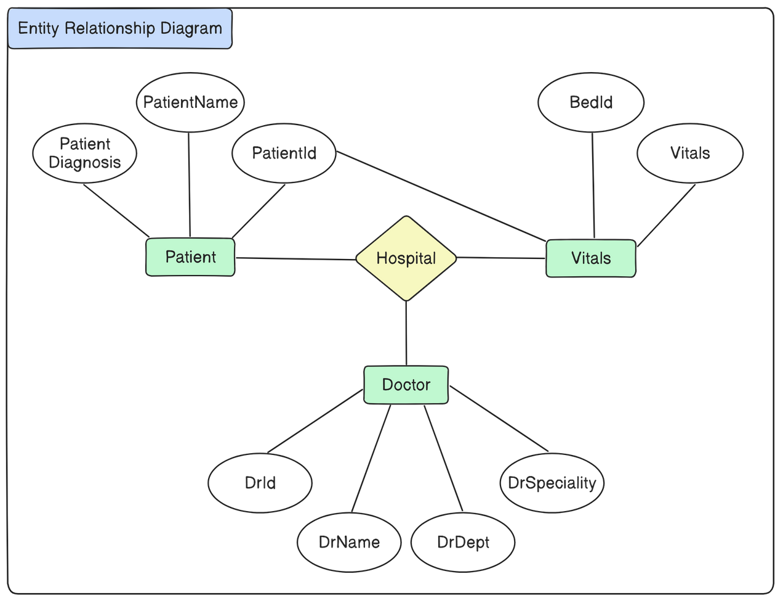
UML Diagrams
Slide No: 30

Slide 35
B1902304221
Software Requirements Specification
https://docs.google.com/document/d/1E40Xc2aNrkZF9mwuJU0yzXMg0TlWWj8fZ8sv3i0E0wI/edit?usp=sharing
Slide No: 25
Slide No: 31

Slide 36
Applications
ICU Patient Monitoring
Remote ICU Supervision
Data-Driven Treatment Planning
Hospital Management and Resource Allocation
Clinical Trials and Research
Early Warning Systems
Slide No: 22
Slide No: 32

Slide 37
Future Scopes
Scalable Solutions for Other Hospital Departments
Mobile and App-Based Access
Personalized Medicine:
Treatment plan suggestion
Slide No: 23
Slide No: 33

Slide 38

Conclusion
Through rigorous discussion, survey, and objective assessment, we are here to conclude.
Hence, through rigorous consideration and survey, we have fixed our B.E project on this subject to further learn various software and make something practically usable for organizations around us, driving a change.
Slide No: 34

Slide 39
References
B. Joel, S. Sibi Rajan, R. Vibinanth, D. Pamela, and P. Manimegalai, “I-Doc – A Cloud Based Data Management System For Health Care,” 2022 6th International Conference on Devices, Circuits and Systems (ICDCS), Apr. 2022.
2. D. Akhil, M. V. Vardhan, K. V. Reddy, C. Preetham and N. Sangeeta, "Iot Based Icu Patient Monitoring Smart System," 2024 3rd International Conference on Artificial Intelligence For Internet of Things (AIIoT), vol. 13, pp. 1–6, May 2024.
3. M. D. Aldhoayan and Y. Aljubran, “Prediction of ICU Patients’ Deterioration Using Machine Learning Techniques,” Cureus, May 2023.
4. C. V. Ravikanth, Kolangiammal, K. Chegondi, and V. Gowtham, “Cardio Monitoring and Cardiac disease prediction using Machine Learning,” 2023 International Conference on Recent Advances in Electrical, Electronics, Ubiquitous Communication, and Computational Intelligence (RAEEUCCI), pp. 1–6, Apr. 2023.
5. S. C, V. R, K. Sreelatha and S. V, "SIPMS: IoT based Smart ICU Patient Monitoring System," 2023 International Conference on Artificial Intelligence and Knowledge Discovery in Concurrent Engineering (ICECONF), Chennai, India, 2023, pp. 1-7.
6. A. Ahmed, M. T. Mahmud, and M. M. Khan, "Info Hospital: Web/Mobile Application based Health Care System," 2022 6th International Conference on Computing Methodologies and Communication (ICCMC), Erode, India, 2022, pp. 1546–1552,
Slide No: 34

Slide 40
Thank You

